Slide 1

Designing image-based control systems considering workload variations
Sajid Mohamed¹, Asad Ullah Awan², Dip Goswami¹, Twan Basten¹
¹Eindhoven University of Technology, The Netherlands
²Technical University Munich, Germany

Slide 2
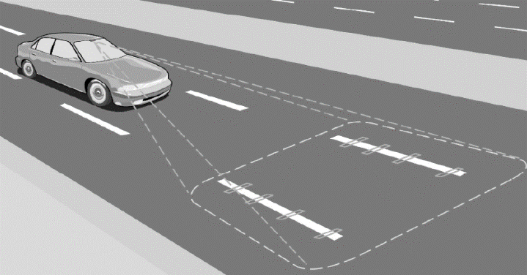




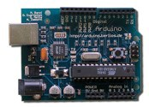





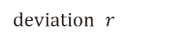
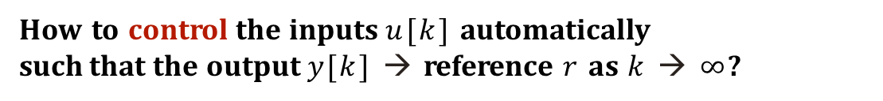
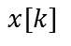
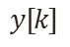
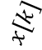
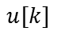
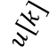
Image-based control (IBC) system – an example
$$x[k]$$
$$u[k]$$
Vision-based lateral control of a vehicle
electronic
control unit
vehicle on road
disturbance
Control Strategies
steering angle
desired lateral
lateral deviation
deviation $r$
$$u[k]$$
$$y[k]$$
$$x[k]$$
measure states
How to control the inputs $u[k]$ automatically such that the output $y[k]$ → reference $r$ as $k$ → $∞$?
Control objective

Slide 3
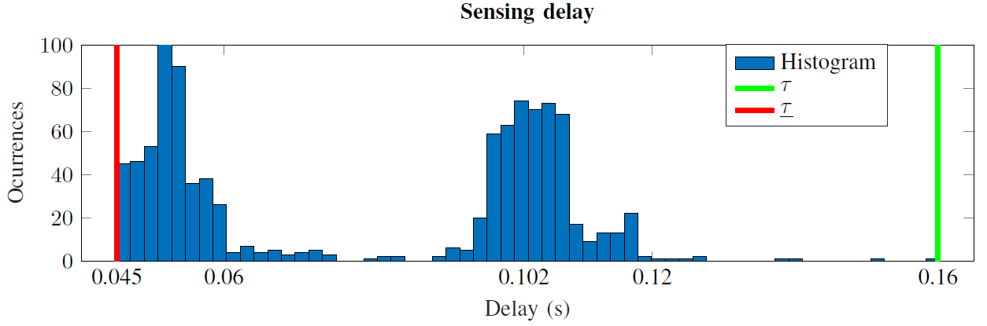
IBC system: characteristics
Sensing delay is relatively long
applicable for 30 or 1000 frames per second (fps)
Sensing delay more than frame rate
dropped camera frames
Sensing delay is variable
workload variations
do not know the exact sequence of occurrence apriori
P₀
time
3

Slide 4
IBC system: characteristics
Sensing delay is relatively long
applicable for 30 or 1000 frames per second (fps)
Sensing delay more than frame rate
dropped camera frames
Sensing delay is variable
workload variations
do not know the exact sequence of occurrence apriori
P₀
time
How to cope with this long, variable sensing delay to improve system performance?
QoC
4
Utilisation
Energy

Slide 5
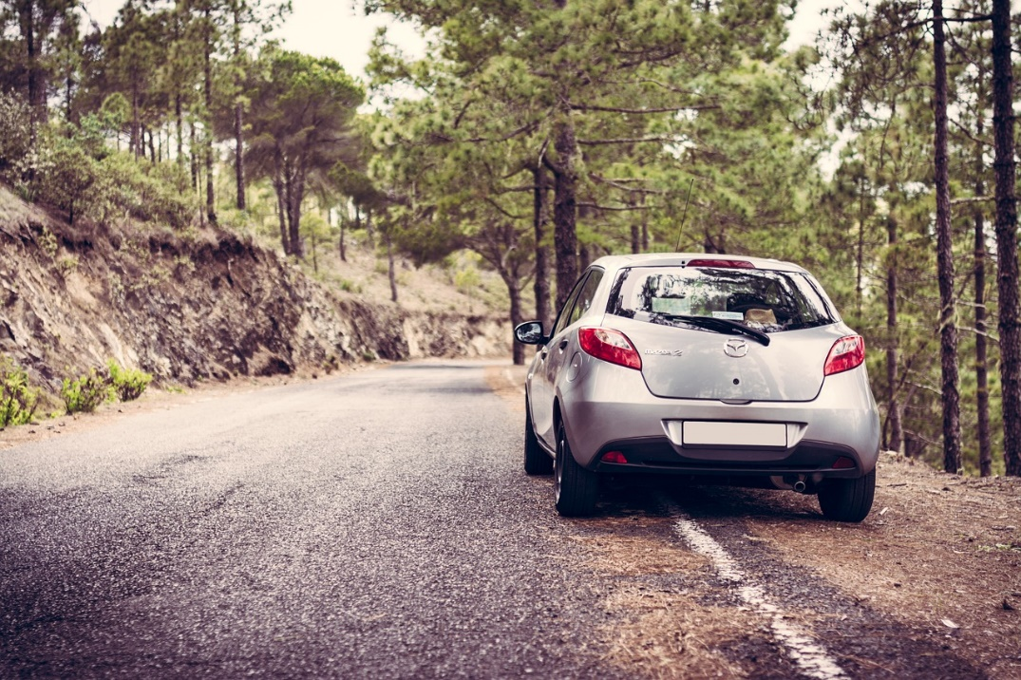
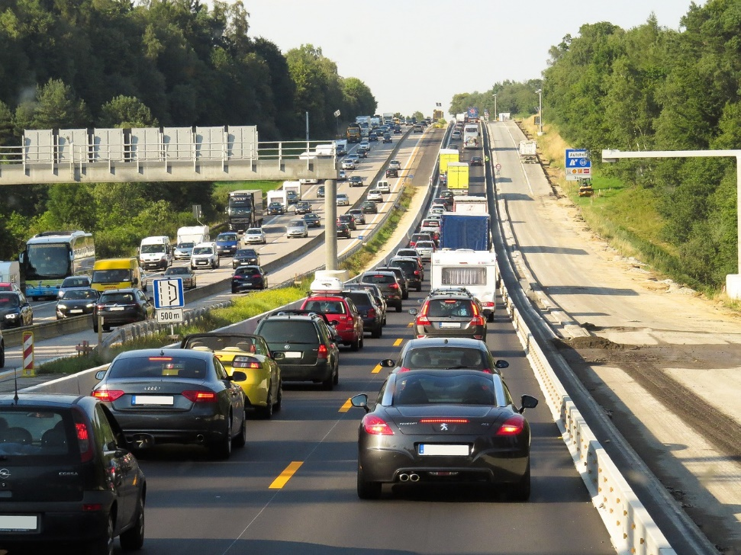
Workload Variations
t
t
time
5

Slide 6
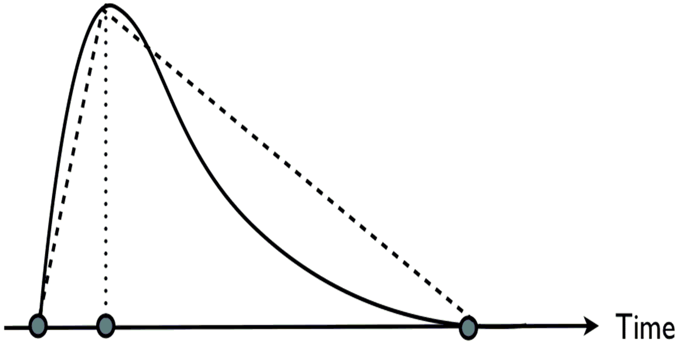
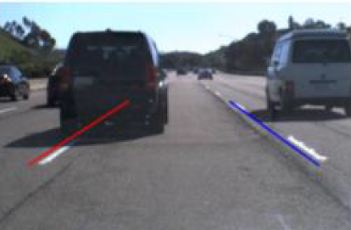
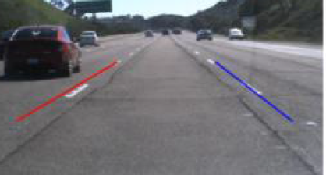
Workload Variations
Workload distribution
best-case
worst-case
Average workload
Minimal workload
τ
S
C
A
S
C
A
S
C
A
0
100
200
time (ms)
Execution time of ‘S’ depends on workload variation
A constant sensor-to-actuator delay τ and sampling period h → to guarantee system stability

Slide 7
The Design-Implementation Gap
Workload distribution
best-case
worst-case
Average workload
Minimal workload
rarely happens
idle time
S
C
A
S
C
A
S
C
A
0
100
200
time (ms)
Controllers designed for worst-case workload → rarely happens
Idle resources for less workload → inefficient resource utilisation

Slide 8
Related Work
Control domain
Robust design
Reconfigurable pipelining
Model predictive control
State estimators
…
Embedded domain
Model-based design
System-scenario based design
…
Co-design
Platform-aware switched systems
…
Does not model and explicitly consider
platform constraints
workload variations (exact sequence not known apriori)
Does not optimise for Quality-of-Control considering workload variations
Difficult to guarantee stability
*see paper for references

Slide 9
Contributions
How can we optimise Quality-of-Control for given requirements, implementation constraints and system knowledge?
Platform-aware controller synthesis
based on Markovian jump linear system (MJLS) formulation
comparison:
optimal control (LQR)
platform-aware switched linear control (SLC)
Design guidelines for given
requirements: performance and/or energy
implementation constraints: camera fps, platform allocation, mapping
system knowledge: probability of workload occurrences and transition probabilities
9

Slide 10
Markovian jump linear system (MJS) formulation
sampling periods and delays for Markov states
system model
Discrete-time Markov chain
MJS Formulation
switching control system

Slide 11
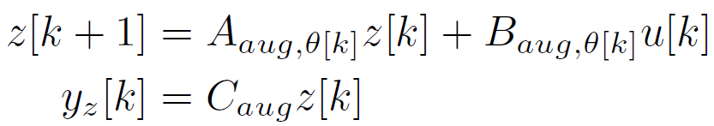
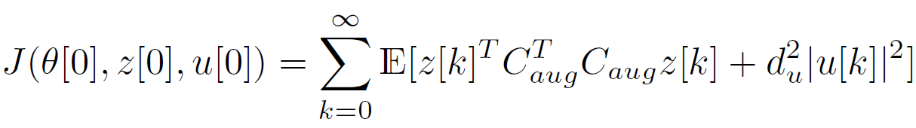
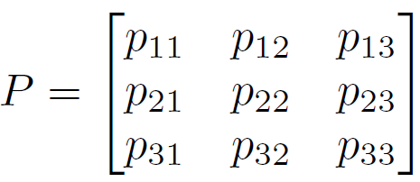
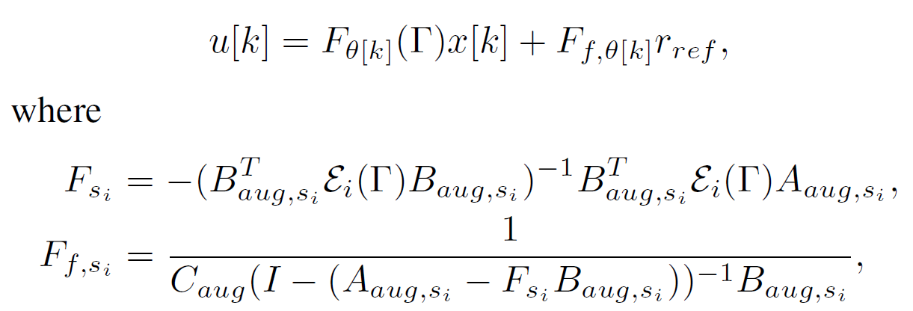
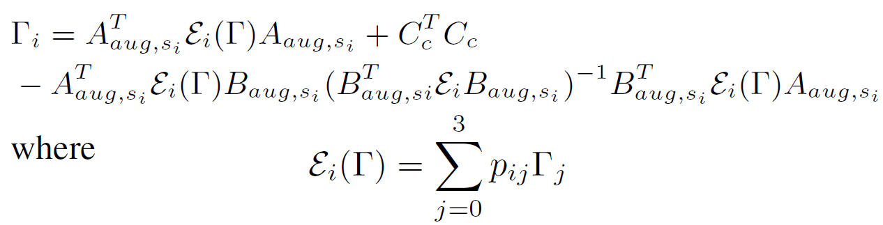
Markovian jump linear system (MJS) formulation
Model workload variations as a discrete-time Markov chain
requires frequently occurring workloads and their transition probabilities
solved using coupled algebraic Riccati (matrix) equations (CARE)
S₁
S₂
S₃
S
C
A
S
C
A
S
C
A
11

Slide 12
A scenario- and platform-aware design approach
Identify, model, and characterise workload (scenario) variations
PERT distribution
Discrete-time Markov chain
Find optimal mappings for a given platform allocation
SDF3* flow
Identify system scenarios
Implementation constraints
Design a controller
Markovian jump linear system (MJS)
LQR with worst-case sampling period
Switched linear control (SLC) system
IBC Application
Other Applications
Camera(s)
Platform
Application
Platform
Model(s)
Model
Timing
Design-Space Exploration and Pareto-Optimisation
Analysis
Binding +
Controller
Scheduling
Design
Reconfiguration
Mechanism
Mapping
Controller
Configurations
Configurations
*www.es.ele.tue.nl/sdf3/
Notes:
PERT distribution – information on frequently occurring workloads
Discrete-time Markov chain – workloads and their transition probabilities

Slide 13


Scenarios based on workload
How to identify, model and characterise workload variations for IBC design?
PERT distribution, Discrete-time Markov chain
13

Slide 14
Model-of-Computation: synchronous dataflow (SDF)
Actor, channel, tokens, rates
state
proc₂
d,1
proc₁
d
t
proc₂
d
d,1
proc₁
d
t
14

Slide 15
Model-of-Computation: synchronous dataflow (SDF)
Actor, channel, tokens, rates
state
proc₂
d,1
proc₁
d
1
2
t
15

Slide 16
Why platform-aware?
RoIP
RoID
RoIM
C
A
RoIP
1
P₁
RoIP
(h₂, τ₂)
P₀
RoIP
RoIM
C
A
(h₁, τ₁)
P₀
RoIP
RoIP
RoIM
C
A
30 fps
16

Slide 17
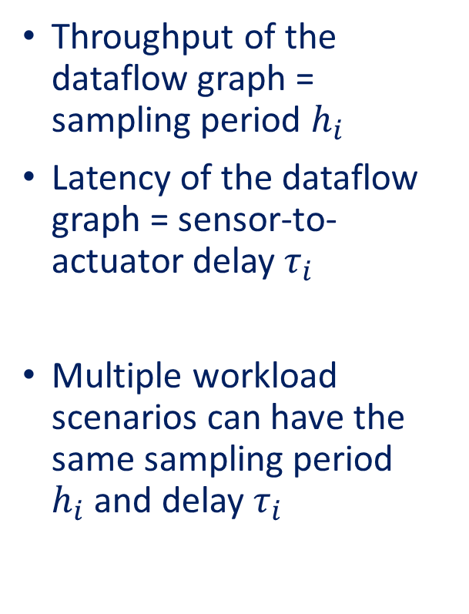
Workload scenarios
(a)
(b)
Throughput of the dataflow graph = sampling period $h_{i}$
Latency of the dataflow graph = sensor-to-actuator delay$τ_{i}$
Multiple workload scenarios can have the same sampling period $h_{i}$and delay $τ_{i}$
RoIP
RoID
RoIM
C
A
(h₁, τ₁)
P₁
RoIP
RoIP
RoIP
C
A
1
P₀
(c)
(d)
2
RoIP
2
(h₂, τ₂)
RoID
RoIM
C
A
P₁
RoIP
RoIP
3
RoIP
3
P₀
RoIP
RoIP
RoIP
RoIM
C
A
1
(e)
(f)
RoIP
P₂
RoIP
RoIP
2
(h₃, τ₃)
2
P₁
RoIP
RoID
RoIP
RoIM
C
A
P₀
RoIP
RoIP
RoIM
C
A
2
2
RoIP
30 fps
1
17

Slide 18
System scenario identification
Based on workload
Based on choice of mapping and choice of parallelization
S₁
S₂
S₃
P₁
RoIP
RoIP
(h₂, τ₂)
P₀
RoIP
RoIP
RoIP
RoIM
C
A
P₁
P₀
S
C
A

Slide 19
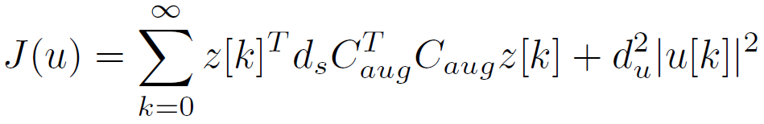
Comparing control design techniques
LQR control design
When only worst-case timing information available
Switched linear control (SLC)
Identify system scenarios
From frequently occurring workload information (e.g. PERT distribution)
Design LQR controller for each identified system scenario
Prove stability (common/switched quadratic Lyapunov function)
S
C
A
S
C
A
S
C
A
S
C
A
S
C
A
S
C
A
19

Slide 20
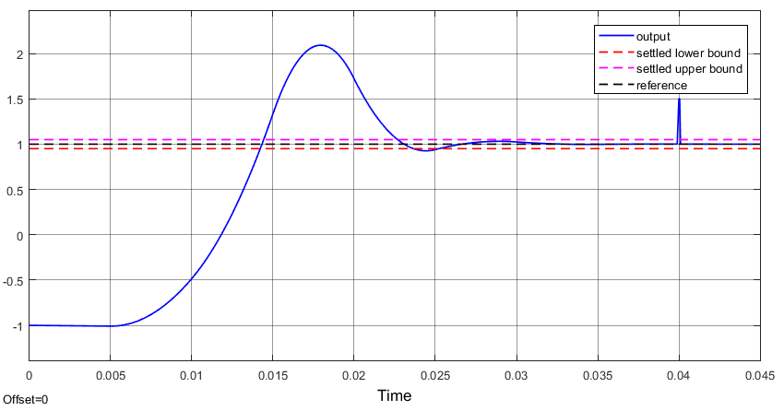
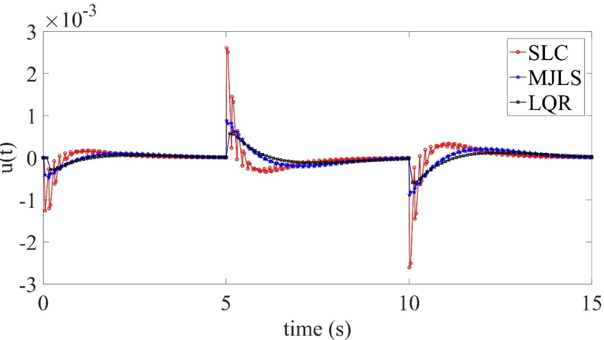
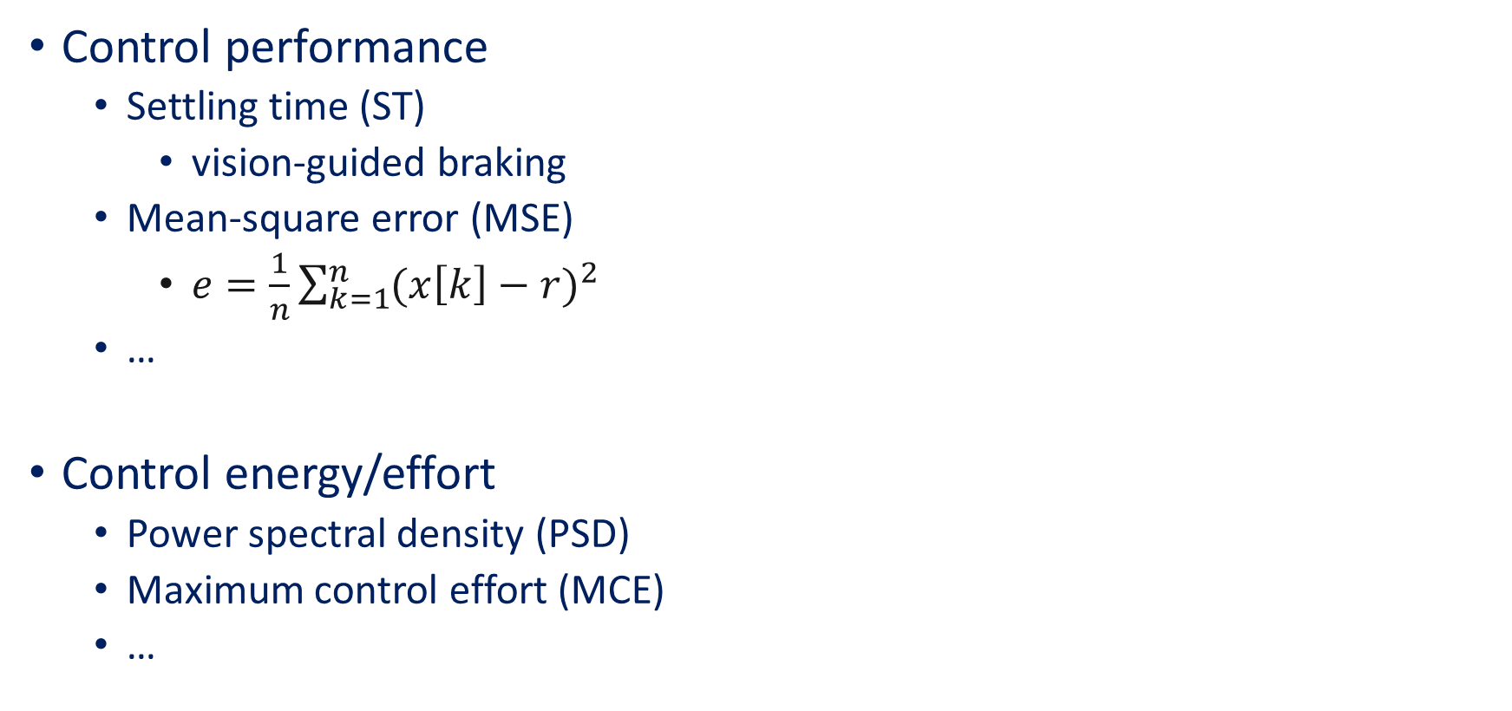
Which Quality-of-Control (QoC) metric to use?
Control performance
Settling time (ST)
vision-guided braking
Mean-square error (MSE)
$e=\frac{1}{n}\sum_{k=1}^{n}{{(x\left[k\right]−r)}^{2}}$
…
Control energy/effort
Power spectral density (PSD)
Maximum control effort (MCE)
…
Settling time

Slide 21
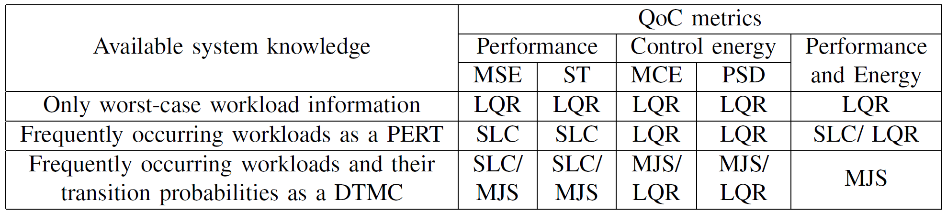
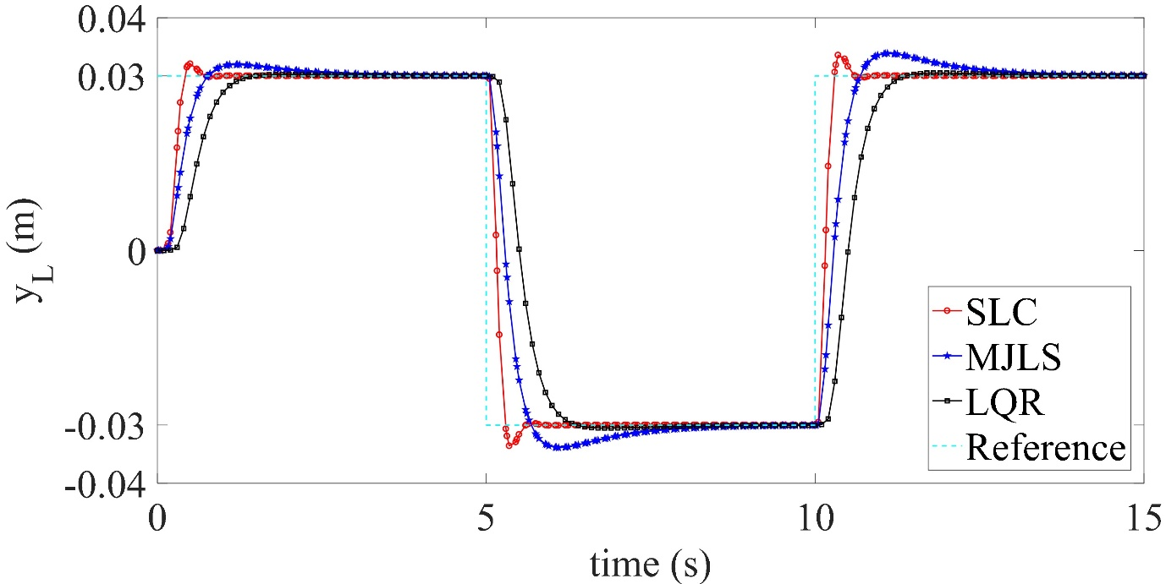
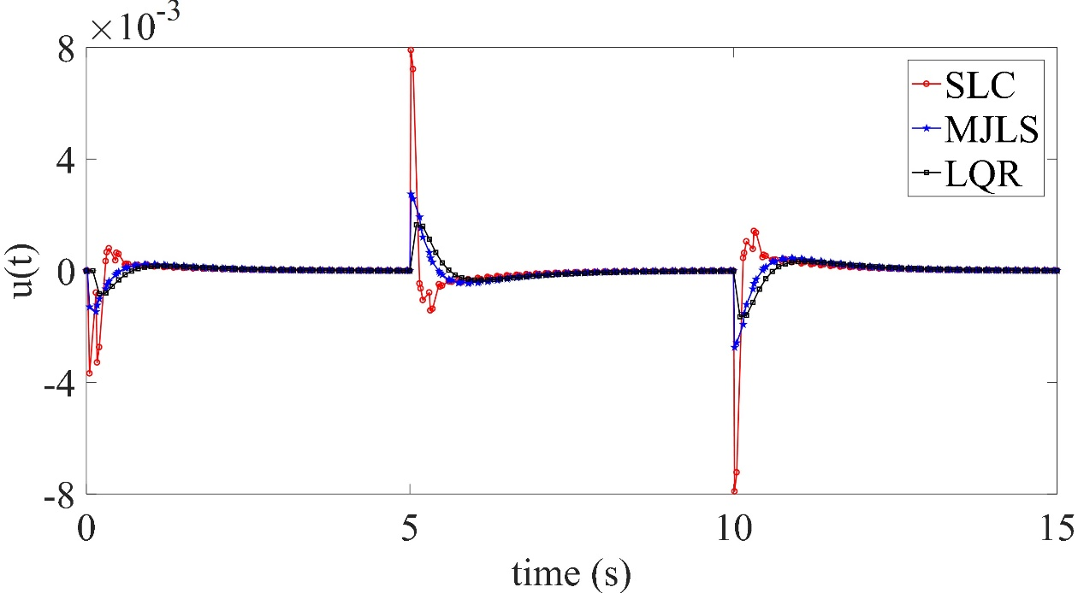
Design guidelines

Slide 22
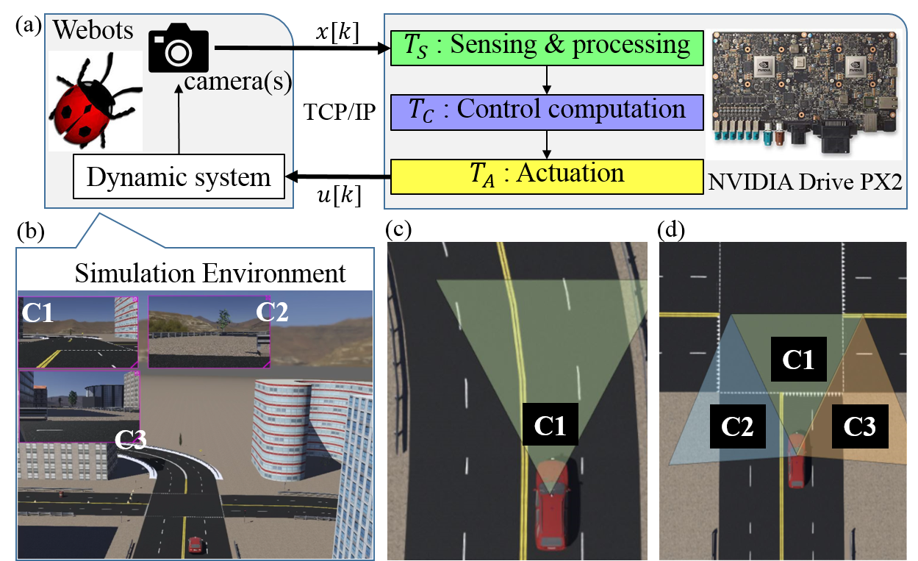
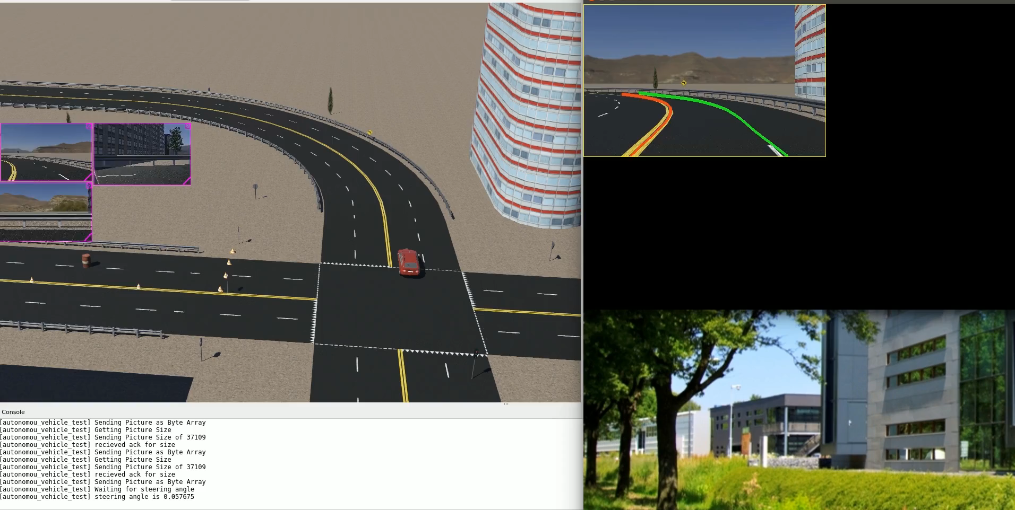
Conclusion
How to cope with long image sensing delay?
A scenario- and platform-aware design approach
Considering workload variations is beneficial
Ongoing work:
A SiL/HiL framework* for validation
Consider parallelisation, pipelining and approximation of sensing tasks
Develop I²C tool based on this approach
Inputs: application and platform model, requirements and constraints
Output: system configurations and controller code
*www.es.ele.tue.nl/~dgoswami/test/imacs

Slide 23
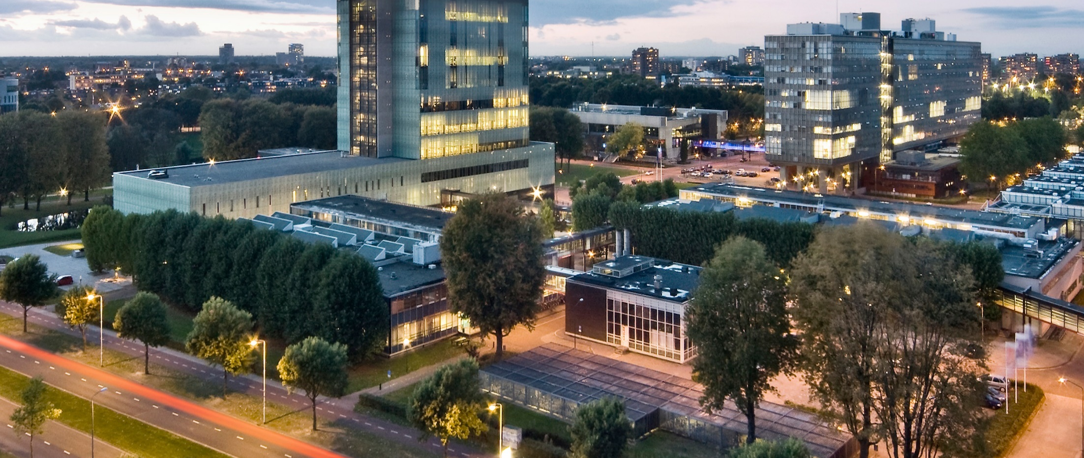


Designing image-based control systems considering workload variations
S.Mohamed@tue.nl
linkedin.com/in/sajidmohamed
Questions?

